Slide 1
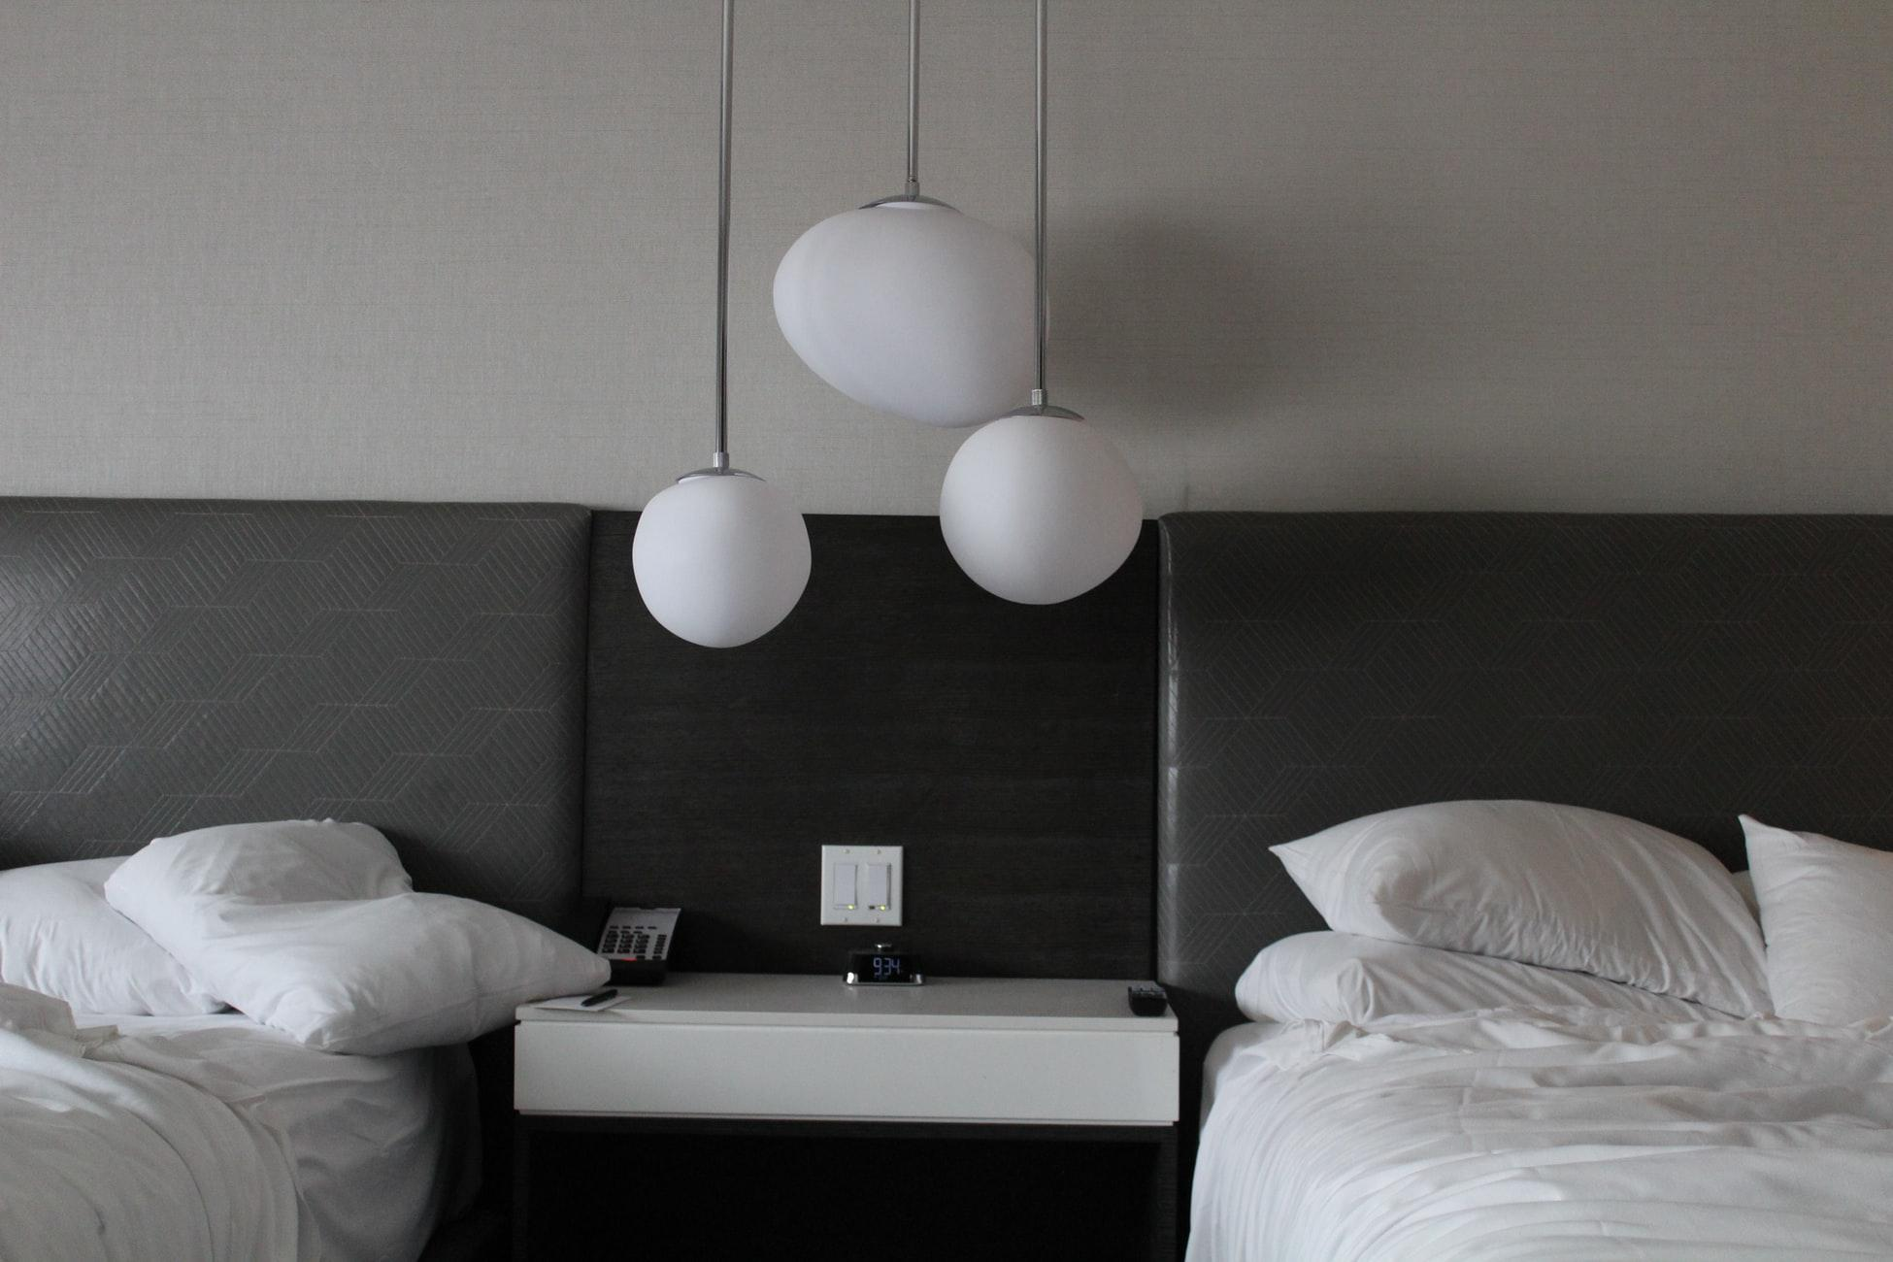
SENTIMENT ANALYSIS & TOPIC MODELLING OF HOTEL REVIEWS
Jing Ying & Mei Xin
Notes:
Good morning everyone! My name is mei xin and this is jing ying. Today we will be covering nlp techniques on hotel reviews.

Slide 2
OUTLINE
01
MOTIVATION
02
DATA
HANDLING
03
SENTIMENT
ANALYSIS
04
TOPIC
MODELLING
05
FUTURE
IMPROVEMENTS
06
POSSIBLE
EXTENSIONS
Why did we embark on this project?
1. Dataset Understanding
2. Data Preprocessing
3. Exploratory Data Analysis
1. Multinomial Naive Bayes
2. Logistic Regression
1. Positive Reviews
2. Negative Reviews
What could have been done better?
How can we take our project to the next level?
Notes:
Before we start, here’s an outline of our presentation. There are 2 parts of our project, i will be covering sentiment analysis and jing ying will be covering topic modelling.

Slide 3
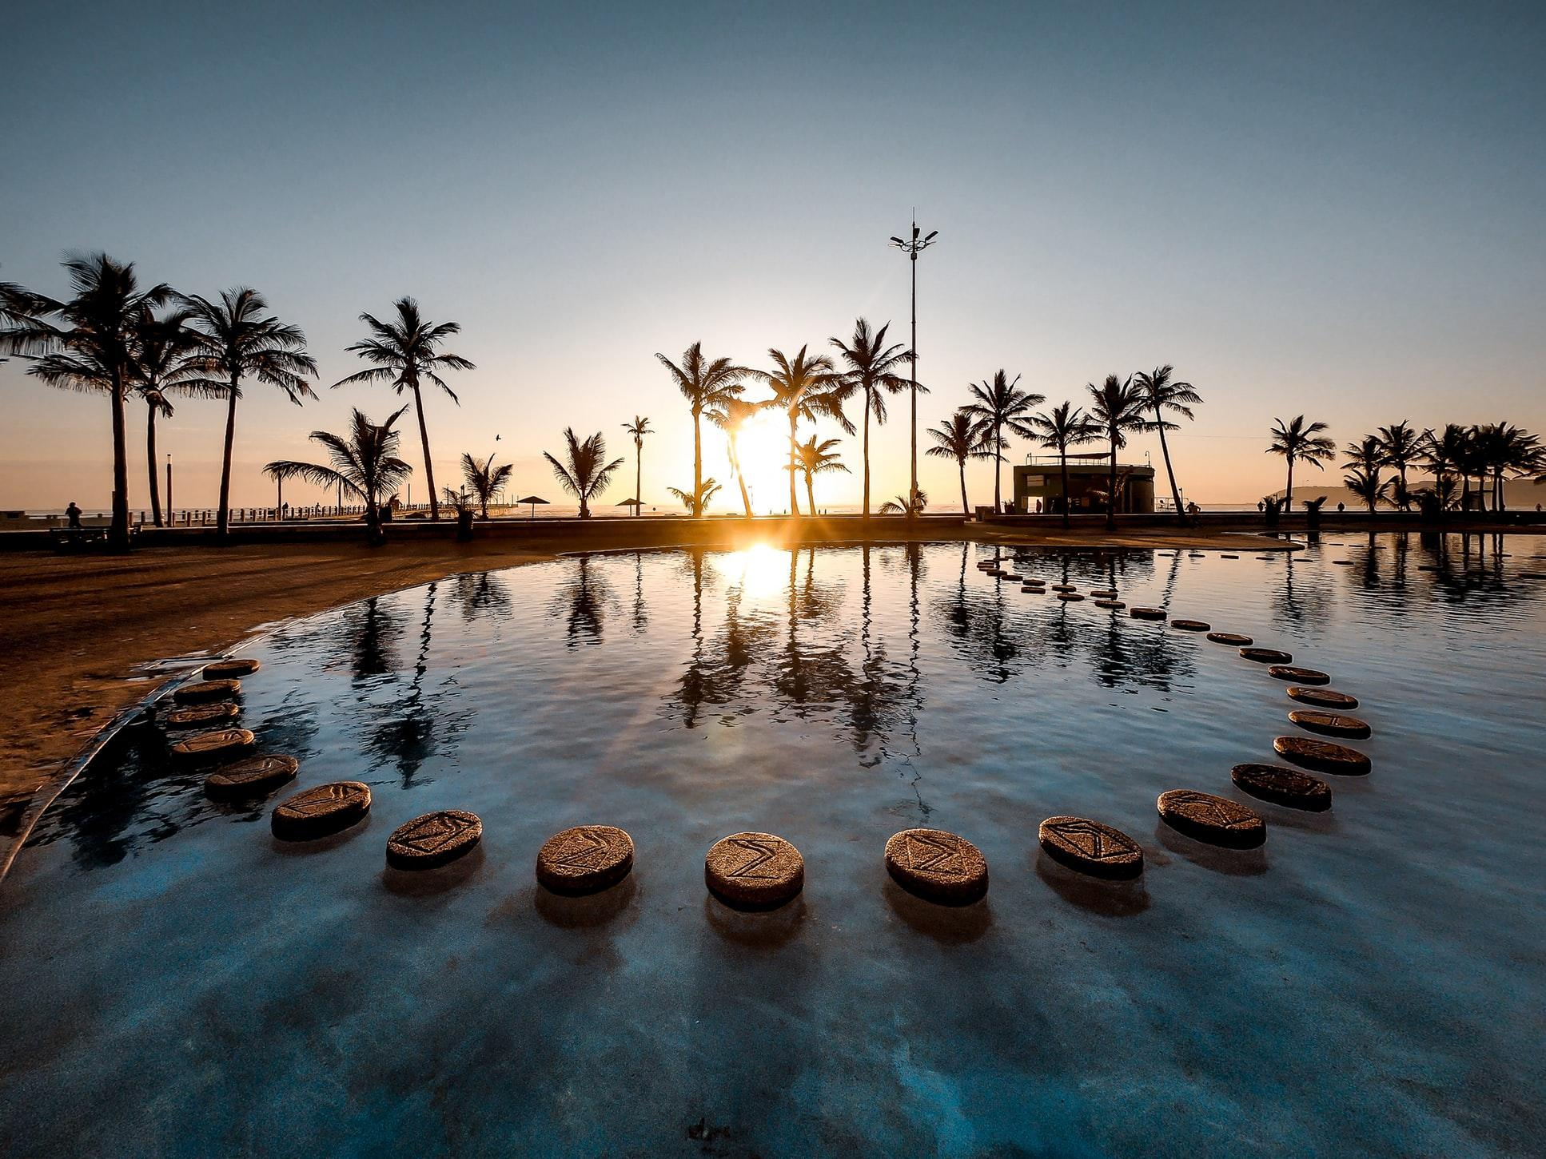
01
MOTIVATION
Why did we embark on this project?
Notes:
Just a fun fact, Jing ying and i like to travel a lot and we have much experience staying in different hotels and on personal level, why we choose to investigate hotel reviews is because we think it will be great if we can know which hotel is good to stay and which hotel to avoid for our travel next time.

Slide 4



MOTIVATION
Customer reviews to improve hotel service
What do customers care about ?
Notes:
We also find it applicable to business context, whereby big hotels like Carlton and four seasons, there are millions of reviews on their service. But it’s difficult for the managers to read through all the reviews. So business nowadays are interested in using sentiment analysis to quickly classify the reviews to positive and negative ones, so that they can better improve their services. And after able to analyse the attitude of customers towards the hotels service, we also want to know what they are dissatisfied about. Here comes the importance of topic modelling which helps us to identify key words in reviews which can imply what customers care about when they stay in your hotel.

Slide 5

02
DATA HANDLING
1. Dataset Understanding
2. Data Preprocessing
3. Exploratory Data Analysis
Notes:
Our dataset we obtain is from kaggle competition, which have 500k reviews gathered from the hotels in European region.

Slide 6
DATASET UNDERSTANDING
Average_Score | Hotel_Name | Negative_Review | Positive_Review | Reviewer_Score
7.7 | Hotel Arena | The service was awful They refused to take ownership of a mistake… | The brunch to purchase in the morning was good | 3.3
8.4 | Duret | Dont like the toilet its not even a little bit soundproof | Like the location and near by restaurants | 6.7
Notes:
Dataset has these columns, which have the average score which is the average rating on hotel, hotel name, negative review and positive review score given by each user. The reviews are already classified for you in terms of positive and negative ones and they have kindly remove punctuation for you.

Slide 7
DATA PREPROCESSING
Remove duplicates
Convert uppercase characters to lowercase
Tokenization
Remove stop words
Stemming
Remove short words
“VERY Comfortable Bed and COOL Hotel”
“comfortable” “bed” “cool” “hotel”
Notes:
Before we feed the text, we did preprocessing by converting to lowercase, removing stop words and stemming. We do this to reduce noise in our dataset to improve accuracy.

Slide 8
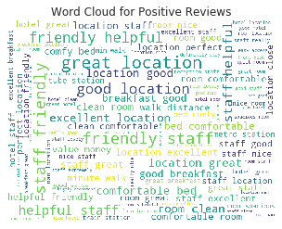
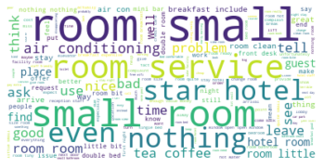
WORD CLOUD
POSITIVE REVIEWS
NEGATIVE REVIEWS
Notes:
EDA on reviews, we find that customers usually talk about the hotel room environment and customer service.

Slide 9

03
SENTIMENT ANALYSIS
1. Multinomial Naive Bayes
2. Logistic Regression
Notes:
The first model that we did was sentiment analysis, which our goal is to be able to classify the reviews into positive and negative ones. Before we feed

Slide 10
WORD EMBEDDING
MODELS
BOW
TF-IDF
Combined with n-grams (1-3)
Logistic Regression
Multinomial Naive Bayes
Notes:
Before we feed into our classifier models, we need to convert the text to numeric models. There are two methods we have considered, one is bag of words : which is to count the number of times a word appears and the other is TF-IDF which measures how important the word is. But the problem is that these two methods is that it does not take into account of the sequence of words in a sentence. So we also explore on how to combine bow and tf-idf with ngrams from 1-3 grams. And the models we choose is logistic regression and naive bayes models which are common for text classification tasks. The thing is we do not know which text-to-numeric models are the best feature extraction in each of our models, so we train the model on each text-to numeric model.

Slide 11
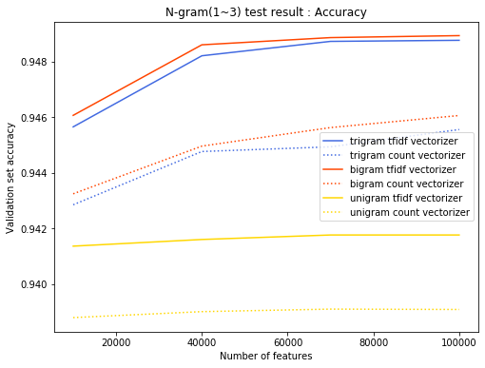
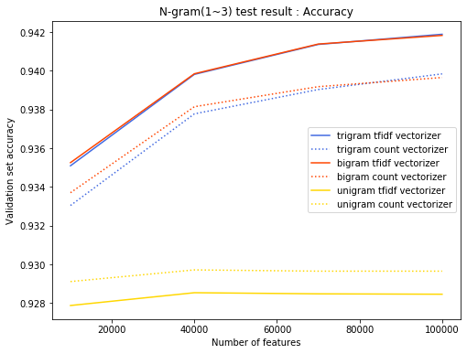
Word Embedding Performance
Logistic Regression
Naive Bayes
Notes:
As you can see when we feed in tfidf ngram and bow ngram in logistic regression, tfidf with bigram technique have the highest accuracy on the testing set, with the accuracy increases slightly with more number of word features we feed in. As for naive bayes, tfidf trigram vectorizer have the highest accuracy. With that we decide to feed in the optimal word embedding models into each of the classification models, and then focus on fine tuning the hyperparameters and k-fold cross validation to improve the accuracy of model.

Slide 12
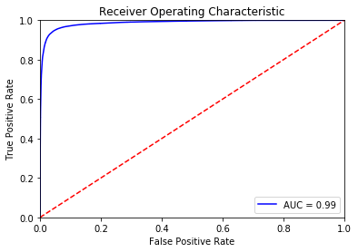

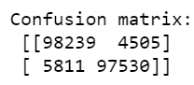
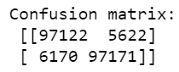
ROC
Logistic Regression
Naive Bayes
Notes:
After we feed in the optimal word embedding extraction to each model, we get quite good result in terms of classification performance. Which both logistic regression and naive bayes have quite high AUC area.

Slide 13
Accuracy
Logistic Regression
Naive Bayes
Precision | 95.1
Recall | 95.1
Training | 96.4
Testing | 95.1
Precision | 94.3
Recall | 94.3
Training | 94.5
Testing | 94.3
Notes:
In terms of accuracy, logistic regression performs slightly better than naive bayes in prediction. And its precision and recall are also slightly higher. Overall the accuracy is better than what we expected, but we also get a little bit greedy. We want to see how we can further increase the accuracy.

Slide 14
Different Cleaning?
Stemming
Lemmatization
Accuracy
LR | 95.1
NB | 94.2
Accuracy
LR | 91.0
NB | 90.2
Notes:
We decided to try different preprocessing techniques on our reviews. So our current cleaning technique is stemming, which have accuracy of 94% and 95%. But when we use lemmatization, the accuracy of our models decrease together with the auc area. Which is really surprising to us because it’s almost a well-known fact that lemmatization always perform better than stemming since they reduce the word to letgitimate roots whereas stemming does not.

Slide 15
WHY??
Lemmatization considers context while stemming does not
Reduction in number of features for TF-IDF to determine
“ Only the park outside of the hotel was beautiful ”
“park hotel beautiful”
Lemmatization
“ only park outside hotel beauti”
Stemming
Notes:
So we try to investigate what could be the reason behind. And we know that lemmatization considers the context of a sentence before it choose whether to remove the inflections or not whereas stemming does not consider context. So let’s say this sentence “no real complaints, the hotel was great”. If it gets lemmatize it will become real complaint hotel great whereas for stemming the word no will still be there. And because of this we have less words available now in our training data, and our tf-idf and ngrams will consider the context of sentence and judge the importance of words. And due to such reduction, this also affects our accuracy.

Slide 16

04
TOPIC MODELLING
1. Positive Reviews
2. Negative Reviews
Notes:
Besides sentiment analysis, we also performed topic modelling on positive and negative reviews separately to discover what customers are satisfied and dissatisfied with. Hotels can then use this piece of information to improve their services.
To carry out topic modelling, we used a LDA model. We chose LDA over other models like LSA because LDA adds an additional probabilistic distribution layer which prevents overfitting and produces better results.

Slide 17
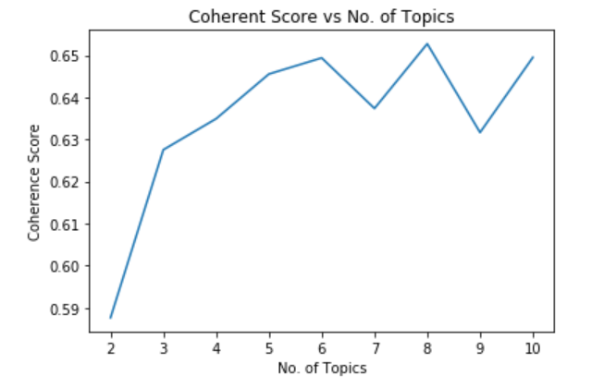
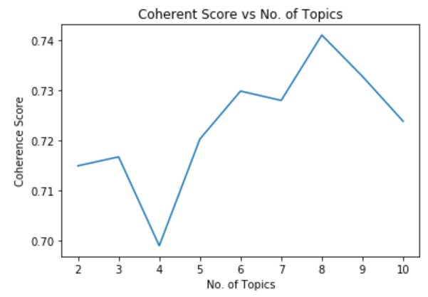
OPTIMUM NUMBER OF TOPICS
Notes:
Topic modelling involves specifying the number of topics. We determined the optimum number of topics by building several LDA models, each with different number of topics, and picking the one that resulted in the highest coherence value. We restricted the number of topics to range from 2 to 10 as we did not want too little topics, which would be meaningless, or too many topics, which might trigger overlapping keywords and pollute results.
From these graphs, we can observe that coherence score is greatest when the number of topics is 8 for both positive and negative reviews. Hence, we selected the two models corresponding to this number of topics.

Slide 18
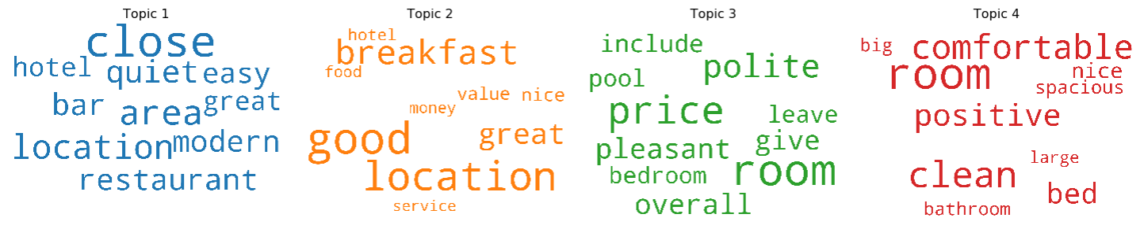
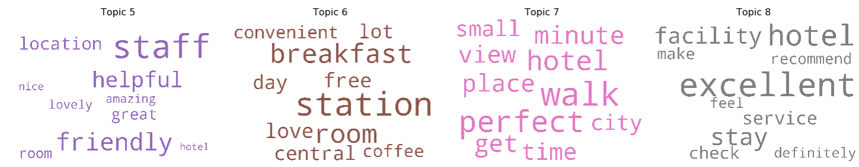
TOPIC VISUALISATION
Notes:
Next, we generated word clouds for the top 10 words in each topic. From the word clouds for positive reviews, we can infer that the topics are: hotel environment, facilities, benefits, room quality, staff service, location, surrounding and feedback. These are thus areas most customers are satisfied with.

Slide 19
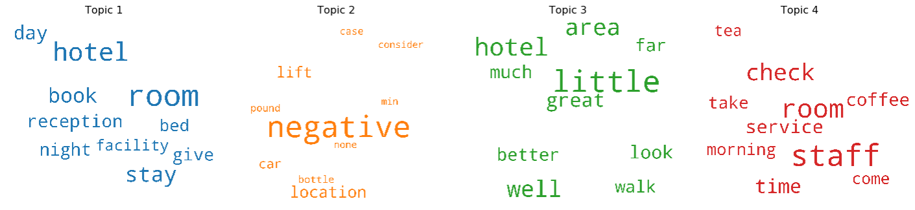
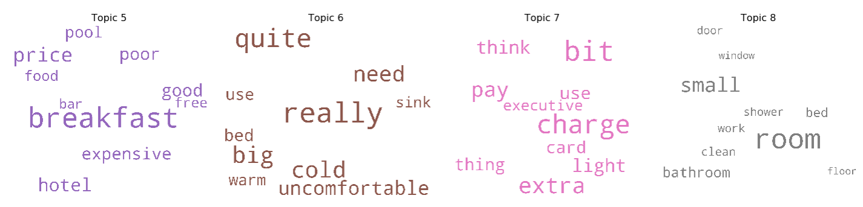
TOPIC VISUALISATION
Notes:
Similarly, from the word clouds for negative reviews, we can infer that the topics are: customer opinion, hotel location, surroundings, staff service, facility, room quality, payment and room cleanliness. These are areas many customers found unsatisfactory and where hotels can improve in. However, we noticed that some words with positive connotations, such as “good” or “clean”, also appeared in these word clouds. This could be due to sarcasm in the language used by customers when leaving reviews.

Slide 20

05
FUTURE IMPROVEMENTS
What could have been done better?
Notes:
Despite obtaining promising results, there is still room for improvement.

Slide 21
FUTURE
IMPROVEMENTS
Explore other models for sentiment analysis
Perform topic modelling over time, grouped by country/nationality
Combine sentiment analysis and topic modelling into a single pipeline
Notes:
We could experiment with more models for sentiment analysis, such as non-linear SVM or 1-dimensional CNN, as there may be others that give higher accuracies than the 3 we tested.
We could also perform grouped topic modelling. Currently, we only explored topics for positive and negative reviews on the whole. Instead, we could perform topic modelling over time to analyse if what customers talked about have changed over the years. Besides that, we could also group reviews by country or nationality to analyse if customers from different countries or of different nationalities talk about different topics.
Lastly, we currently perform sentiment analysis and topic modelling in isolation. We could look into combining sentiment analysis and topic modelling into a single pipeline, where we first identify topics, then analyse the sentiment of reviews under each topic and assign sentiment scores before classifying them as positive or negative.

Slide 22
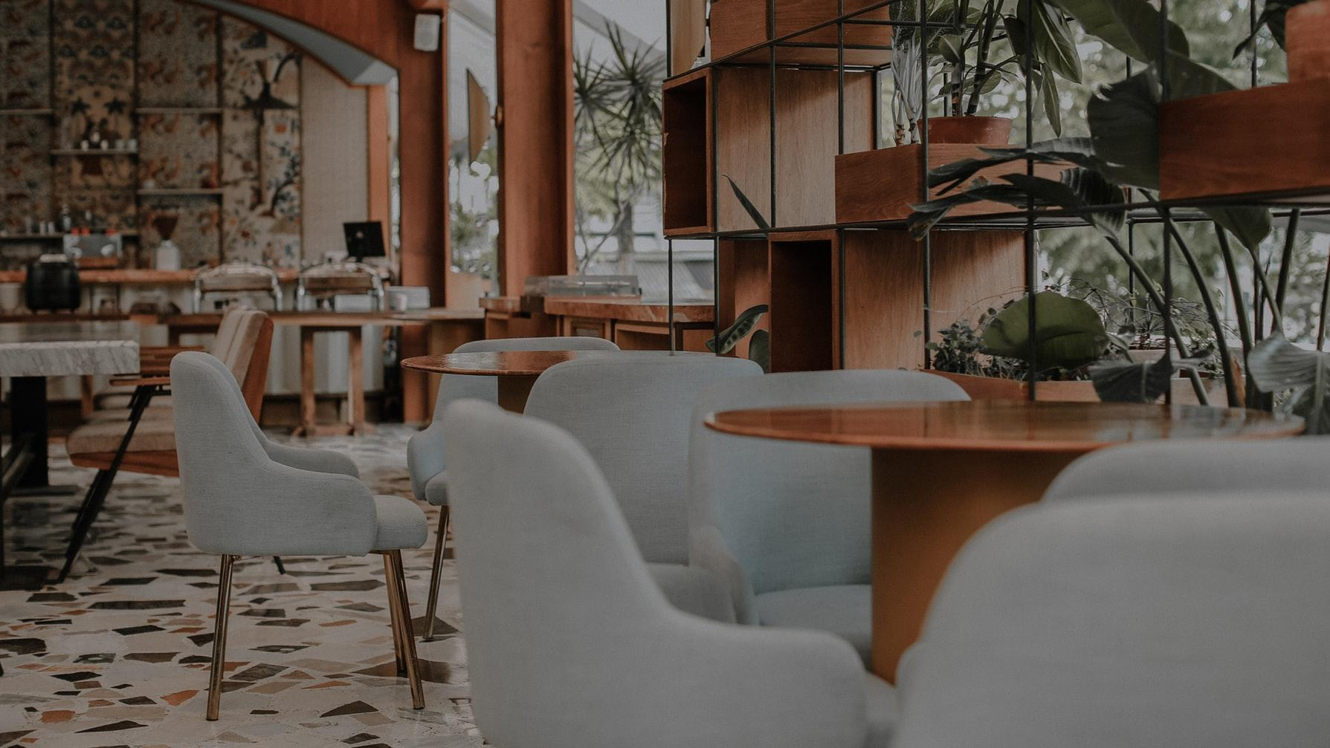
06
POSSIBLE EXTENSIONS
How can we take our project to the next level?
Notes:
Due to time constraints and limit of knowledge, this was the best we could achieve at present. Without these limitations, how can we take our project to the next level?

Slide 23
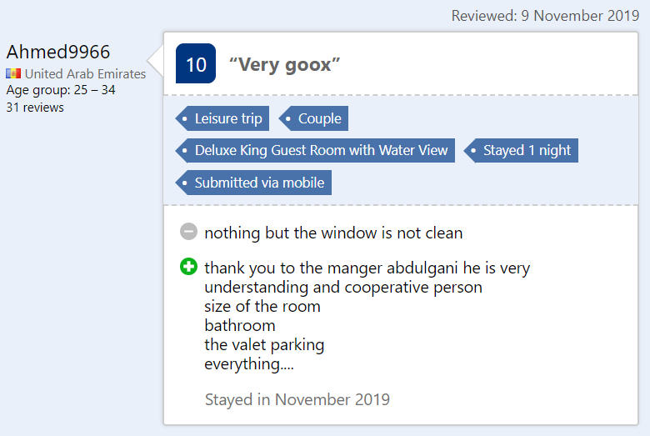
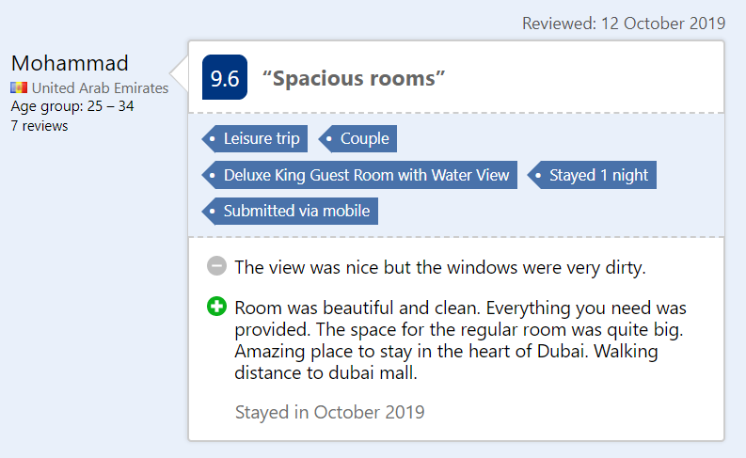
STANDARDISE RATINGS
Notes:
We thought of creating a standardised rating generator. Take these two reviews as an example. Both of them mentioned windows being dirty as a downside of the hotel but the two users gave different ratings. This shows that ratings are subjective and may even be biased. As such, we could look into assigning ratings based on review sentiments to be more standardised and unbiased.
https://www.booking.com/reviews/ae/hotel/renaissance-by-marriott-downtown-dubai.en-gb.html?aid=309654;label=hotel-reviews-english-en-row-b1GwjJzGdDBmCAS01mmoWgS166197672201%3Apl%3Ata%3Ap1%3Ap2%3Aac%3Aap1t3%3Aneg%3Afi%3Atikwd-56245903%3Alp9062512%3Ali%3Adec%3Adm;sid=e6dfcb1cab18799eedc9e52eaf4e9959

Slide 24
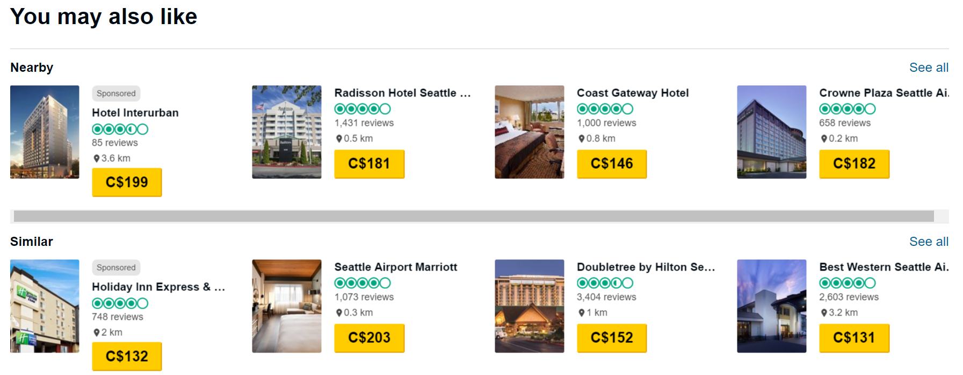
HOTEL
RECOMMENDER
Notes:
We also thought of building a hotel recommender system, where we could analyse hotel descriptions to identify hotels that might be of interest to particular users. Otherwise, we could also recommend hotels based on those with the largest cosine similarity to past hotels booked or viewed by customers or even recommend based on user-specified criteria.

Slide 25

THANK YOU
Notes:
With that, we have come to the end of our presentation. Thank you.

